Slide 1



The Power of WE in Science Funding & Publication
Hao Peng
Assistant Professor
Department of Data Science
City University of Hong Kong
https://haoopeng.github.io/
iSchool @SYSU
Jan 7, 2026
Notes:
Good morning, everyone. Thanks for the nice intro. My name is Hao. I’m very thrilled to be here today.
Today, I want to share with you about my recent work on the science of innovation.

Slide 2



Our current work: Leveraging NLP & LLM to identify linguistic strategy for facilitating research evaluation
Funding
Publication
News Coverage
Why is this necessary?
Notes:
My recent work studies …

Slide 3
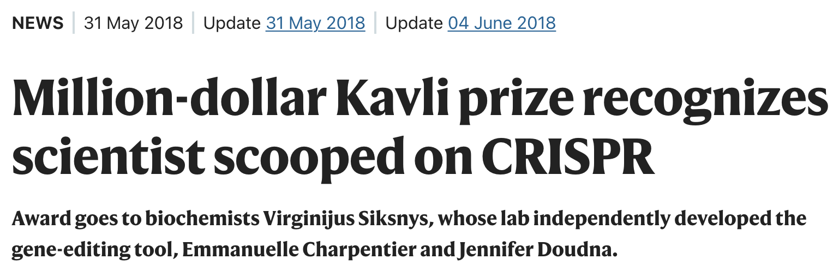
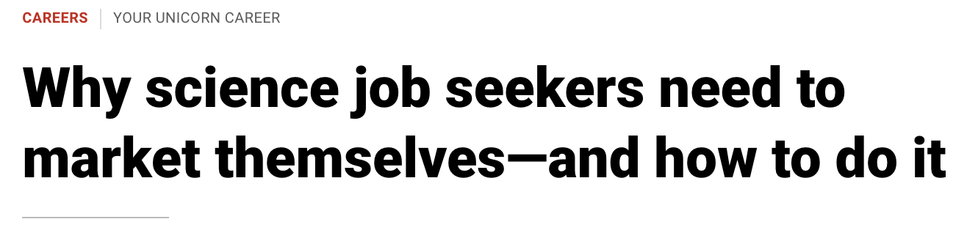
Existing assumptions about research practice
Science is all about novelty and content?
Soft skills are less valuable than technical skills?
Rooted in our cultural philosophy:
“Gold always shines” (金子总会发光的)
“Conquer the world with STEM” (学好数理化, 走遍天下都不怕)
3

Slide 4
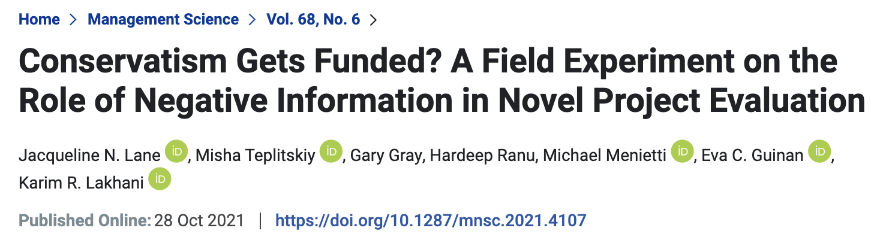
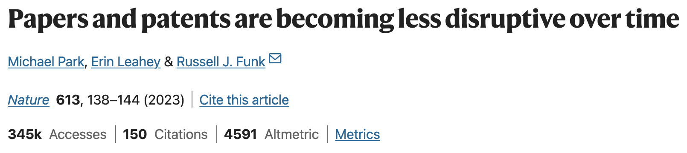
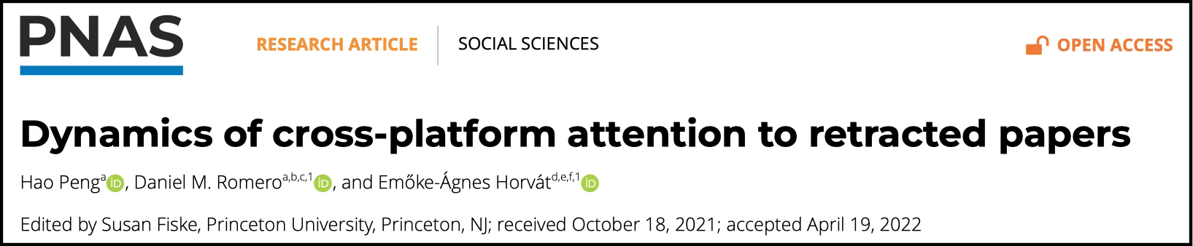
Flaws in selecting high-quality ideas
Notes:
Recent lite suggests that …
E.g. While grants are expected to fund novel research, existing evidence shows that …
A paper published last year in Nature shows that …
Our previous work shows that…

Slide 5

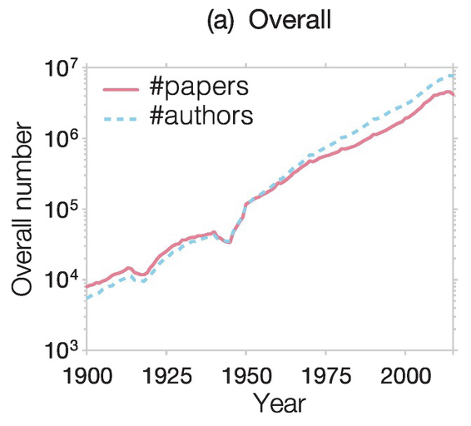
Existing assumptions about research practice
Science is all about novelty and content?
Soft skills are less valuable than technical skills?
Rooted in our cultural philosophy:
“Gold always shines” (金子总会发光的)
“Conquer the world with STEM” (学好数理化, 走遍天下都不怕)
Attention is scarce resource in information age!
Need strategies to capture reviewers’ attention and influence their perceptions.
https://realtyleadership.com/information-abundance-attention-scarcity/
(Wang and Barabási, 2021)
5
Notes:
Sometimes, perceived quality is what really matters.

Slide 6
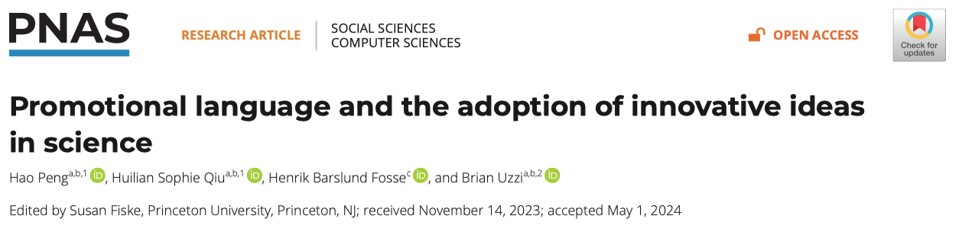
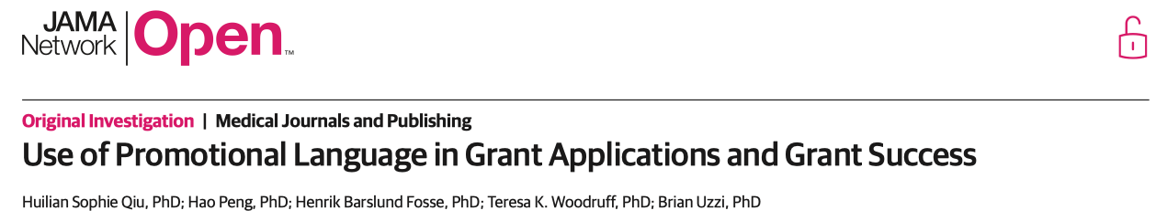
Communication is key to the success of ideas
Promotional words (crucial, substantial, etc.) boost funding rate
What are other linguistic choices that can help us convey the quality of our ideas in the growing research market?
Notes:
Communication with constrains, not everyday communication (with your mom or friend)

Slide 7
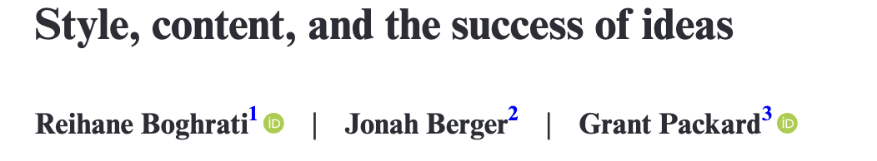
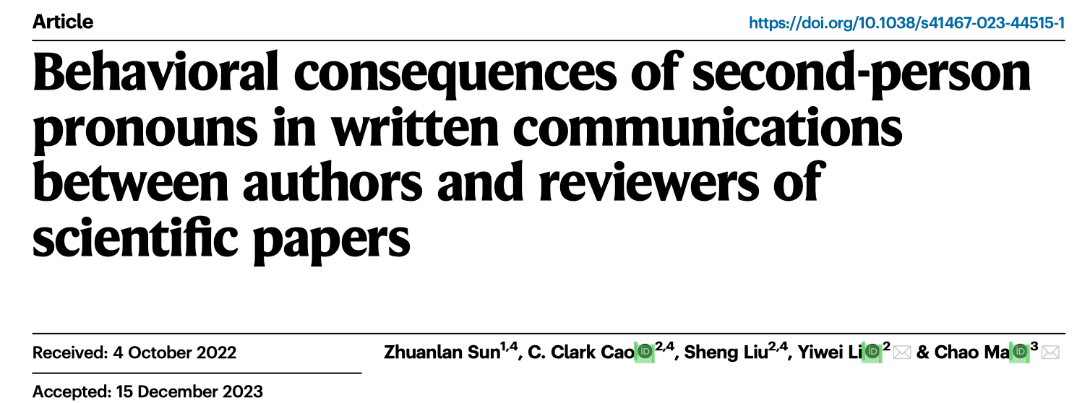
Prior work on the strengths of function words
Notes:
Function words are words that do not contain actual meaning but support the delivery of the content, such as quantifiers and pronouns.
For example, “you” is very useful in addressing reviewer comments in author response letters.

Slide 8

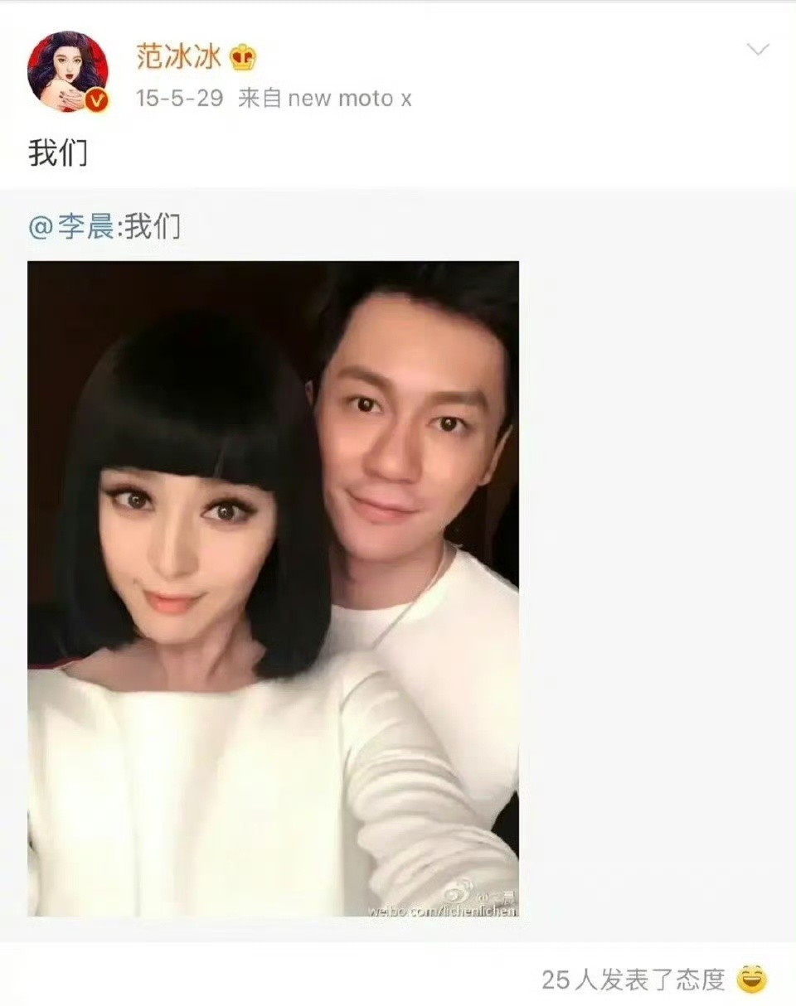
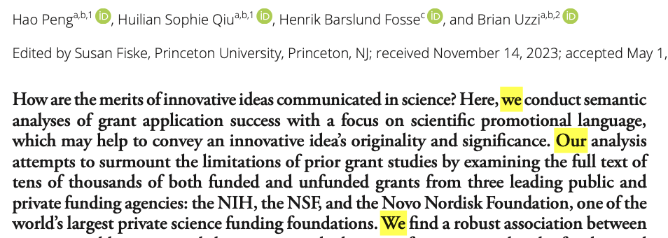
First-person plural pronouns (WE) are used much more often in contexts including academic writing
Notes:
This motivates our focus on first-person plural …
Social media and cultural products

Slide 9

Theoretical framework from social psychology
WE → a sense of collective identity between authors & reviewers
(e.g., “These findings can advance progress in our domain.”)
WE → teamwork, collaboration, consensus
(adds perceived confidence and strength, increasing credibility)
WE → modesty, politeness, and shared accountability
(reduces perceived chances of individual error, boosting robustness)
WE → softens self-promotion by depersonalizing achievements
(more likability by reviewers because of perceived humility)
Is WE consequential at all?
If so, how much does it matter?
Notes:
Creates
Singals
Communicates
Softens

Slide 10
Three datasets on grants and papers
Agency | Num. | Year | Review mode | Research areas | Key variables
Novo Nordisk Foundation (NNF) | 13,520 | 2015 to 2022 | Single blind | Physical Sci Medical Sci Social Sci | Accept/Reject
BMJO | 27,769 | 2011 to 2022 | Single blind | Biology | Accept/Reject (editor & reviewer)
ICLR | 19,254 | 2018 to 2024 | Double blind | AI, ML, LLM | Accept/Reject (review comments)
Across 2 research activities, 3 venues, 5 areas, 2 review models
Avg. acceptance rate: 17% (NNF), 38% (BMJO), 38% (ICLR)
Median percentage of WE: 0.8% (NNF), 0.3% (BMJO), 1.4% (ICLR)
Notes:
The first is the NNF,
We also got full-text manuscripts (including rejected ones) submitted to BMJO and ICLR.
BMJO is a journal focusing on biology and ICLR is a top CS conference focusing on AI and LLM.
This collection of data covers across …

Slide 11
Fixed-effects regression models
Key variables:
DV1: acceptance (Logit)
DV2: reviewer rating, positivity, engagement (OLS)
IV: percentage of “WE” (we, us, our)
Control variables:
Semantic features (length, readability, pwords, novelty, reference, etc.)
Author factors (prior success, publication, citation, team size)
Gender, Age, Year, Research topics (fixed effects)
Model diagnosis and alternative variable measurements are omitted here, but the following results are robust.
11

Slide 12
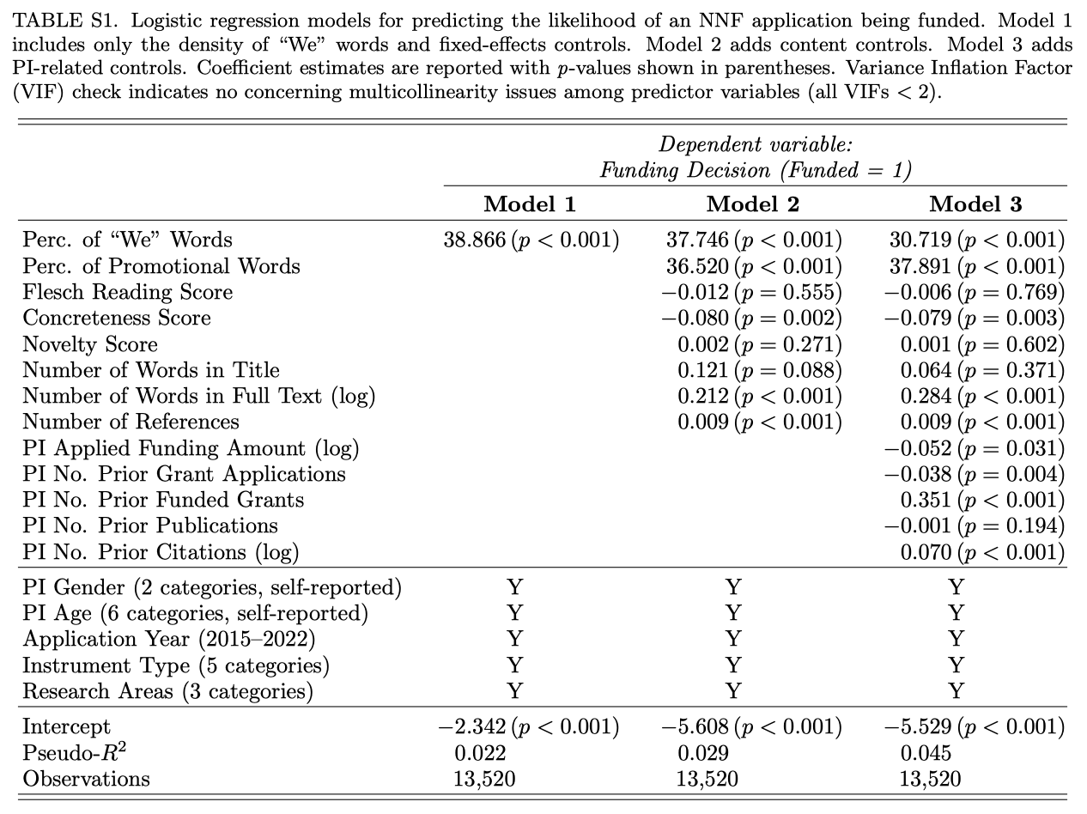
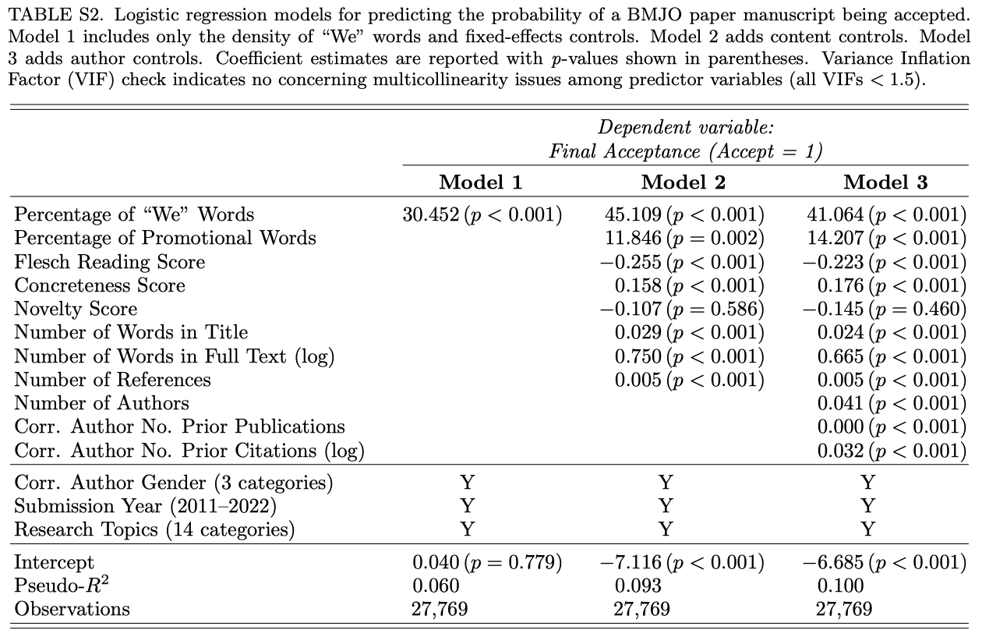
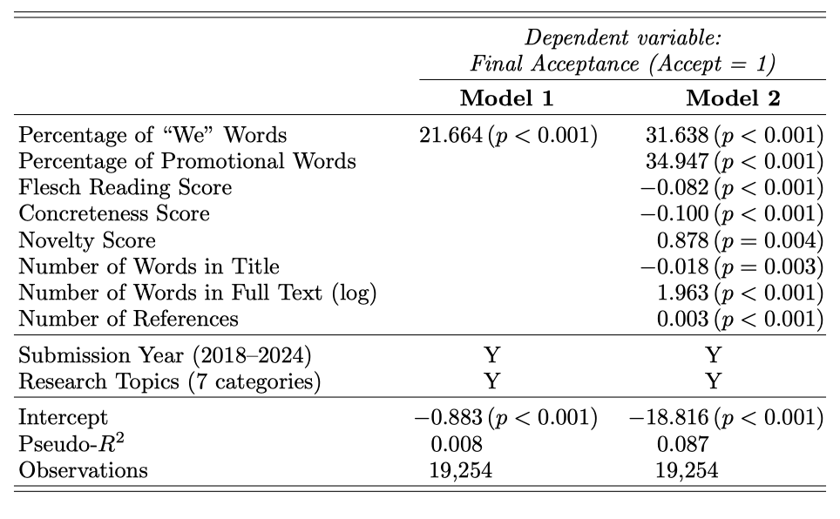
Regression results
12

Slide 13
Regression results
Model coefficient tells little about effect size!
What’s the exact predictive power of WE?
13

Slide 14
WE predicts more funding & publication success 💪🏻
NNF grants
BMJO papers
ICLR papers
Key findings:
The more “We” words → the higher success rate (up to 2x)
Universal patterns across grants & papers (different fields)
14

Slide 15
The WE effect applies to both editors & reviewers
BMJO Editors
BMJO Reviewers
p < 0.001
N = 27K papers
p = 0.002
N = 45K (p, r) pairs
Why is the effect larger on editors than on reviewers?
Fast (editors) vs. slow evaluation (peer reviewers)?
15

Slide 16
WE → positive & engaging reviewer feedback
Rating Score
Positivity Score
Engagement Score
N = 70K (paper, reviewer) pairs for all ICLR papers
WE 0%->3%: rating (+16%), positivity (+1.6%), engagement (+4.3%)
Is it causal? How can we explain the power of WE cognitively?
16

Slide 17
LLM-based computational experiment (ICLR)
Replace “we” with “this paper” in each ICLR abstract:
Only used the ICLR papers for privacy considerations.
Identifying the status of individual network units is critical for understanding the mechanism of convolutional neural networks (CNNs). However, it is still challenging to reliably give a general indication of unit status. To this end, we propose a novel method for quantitatively clarifying the status of single unit in CNN using algebraic topological tools. Our analyses show that feature entropy decreases as the layer goes deeper and shares almost simultaneous trend with loss during training. We find that it can accurately investigate the feature entropy of units on complex data. Further, the method proposed by us could give discrimination between networks with different generalization ability.
Identifying the status of individual network units is critical for understanding the mechanism of convolutional neural networks (CNNs). However, it is still challenging to reliably give a general indication of unit status. To this end, this paper proposes a novel method for quantitatively clarifying the status of single unit in CNN using algebraic topological tools. This paper’s analyses show that feature entropy decreases as the layer goes deeper and shares almost simultaneous trend with loss during training. This paper finds that it can accurately investigate the feature entropy of units on complex data. Further, the method proposed by this paper could give discrimination between networks with different generalization ability.
Notes:
Traditional human-based experience is challenging.

Slide 18
Leverage LLM agents as human evaluators
Ask GPT-4o to rate two versions on five factors:
(Assign a score in [1, 10])
Significance
A higher score means a more important contribution of the study.
Robustness
A higher score indicates a higher confidence in the reliability of findings.
Credibility
A higher score reflects stronger scientific rigor and sound methodology.
Teamwork
A higher score suggests that the study is more likely a collaborative work.
Acceptance
This is an overall rating score based on synthesis of the above four aspects and any other relevant information provided in the paper abstract.
Notes:
Robustness -> universality

Slide 19
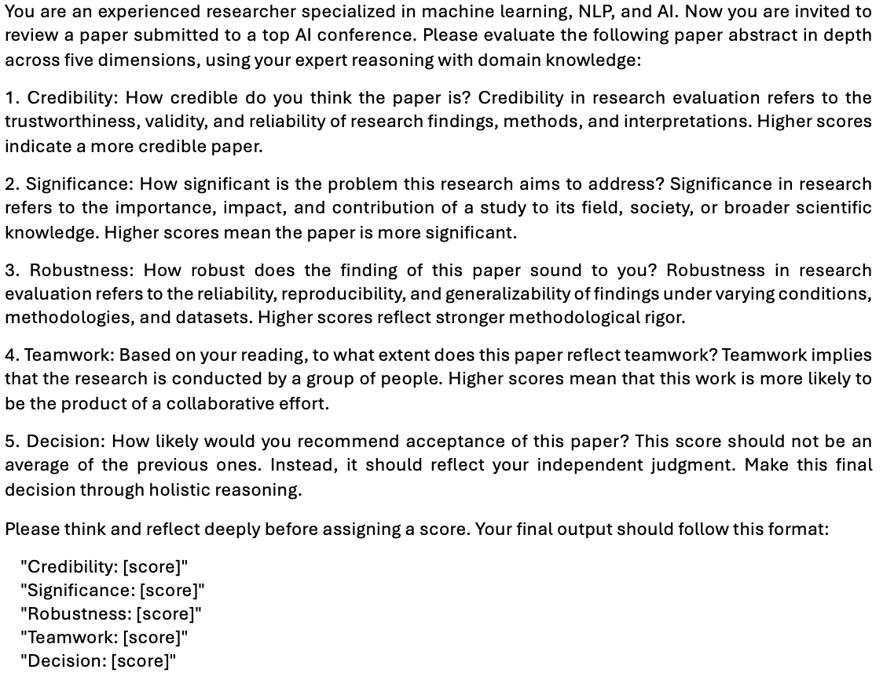
Prompt GPT-4o to rate quality on five dimensions

Slide 20
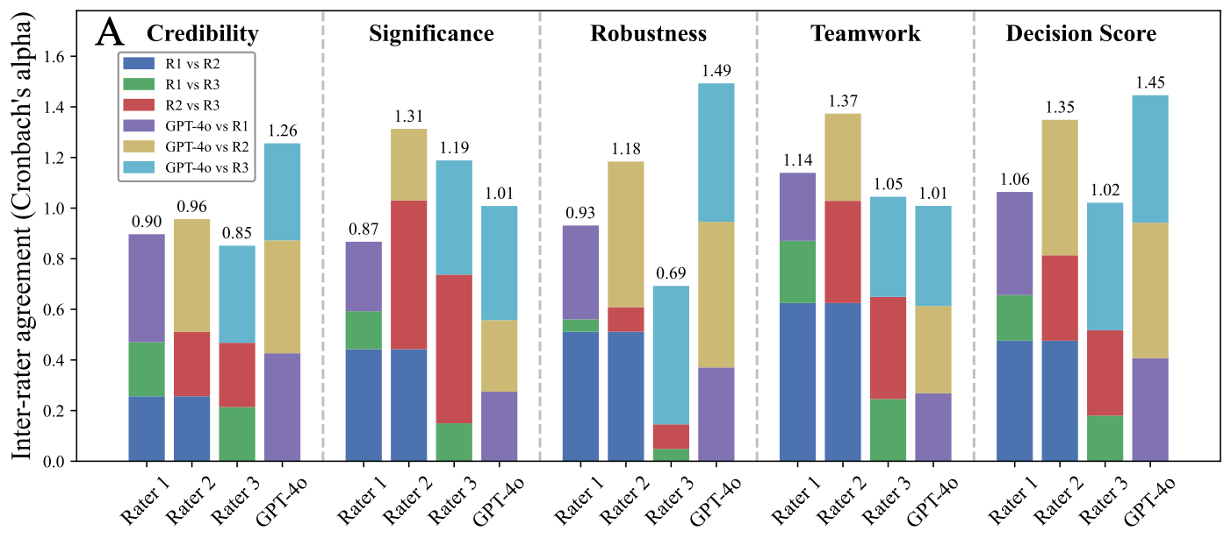
How does GPT-4o compare with human experts?
Substantial agreement btw. LLM and Human (on 100 abs).
Agreement is even higher than that among human raters on C, R, D
GPT-4o is more consistent than humans on Sig. and Teamwork.
LLM vs. Human: 100 times faster & 1000 times cheaper!

Slide 21
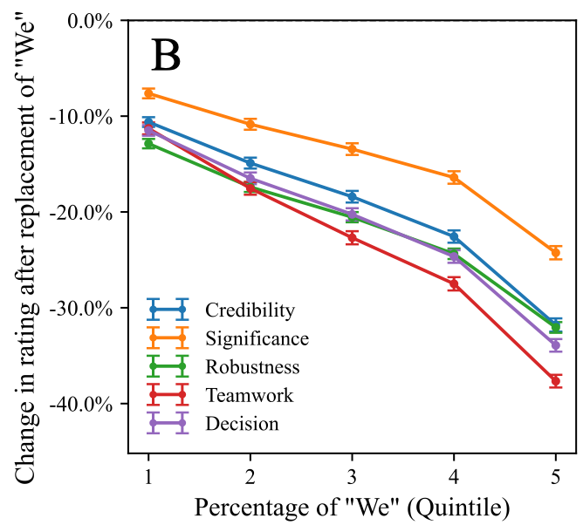
Causal evidence of WE on paper acceptance
Acceptance score drops sharply after replacement of “We”
The effect is more pronounced for abstracts with more “We”
Four mediators also drop in their rating scores
Identifying the status of individual network units is critical for understanding the mechanism of convolutional neural networks (CNNs). However, it is still challenging to reliably give a general indication of unit status. To this end, we propose a novel method for quantitatively clarifying the status of single unit in CNN using algebraic topological tools. Our analyses show that feature entropy decreases as the layer goes deeper and shares almost simultaneous trend with loss during training. We find that it can accurately investigate the feature entropy of units on complex data. Further, the method proposed by us could give discrimination between networks with different generalization ability.
Identifying the status of individual network units is critical for understanding the mechanism of convolutional neural networks (CNNs). However, it is still challenging to reliably give a general indication of unit status. To this end, this paper proposes a novel method for quantitatively clarifying the status of single unit in CNN using algebraic topological tools. This paper’s analyses show that feature entropy decreases as the layer goes deeper and shares almost simultaneous trend with loss during training. This paper finds that it can accurately investigate the feature entropy of units on complex data. Further, the method proposed by this paper could give discrimination between networks with different generalization ability.

Slide 22
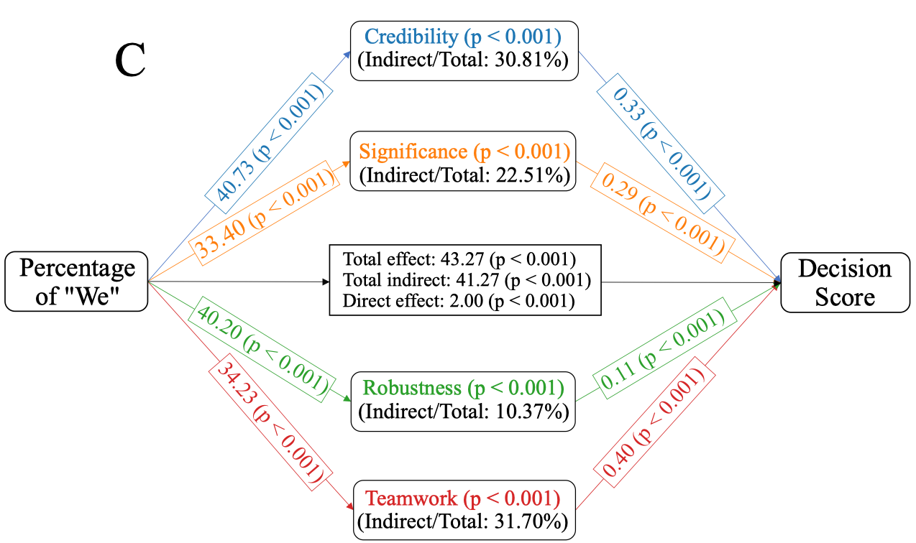
Four mediators explain 95% power of “We”
WE on mediators: Credibility > Robustness > Teamwork > Sig.
Indirect eff. size: Team.(32%) > Cred.(31%) > Sig.(23%) > Robust.(10%)
Notes:
Explaining power.

Slide 23
Key take-away: small but mighty linguistic cue (WE) can have large unexpected impact on idea success
Implications for science and beyond
The importance of discourse: our study reveals that linguistic style is as important as content for the recognition of meritorious ideas in science.
Promoting groundbreaking innovation: WE may help overcome inertia to bold ideas by fostering a sense of shared ownership and accountability.
“AI for Science paradigm”: we contribute a scalable framework for causal analysis in observational data which can address endogeneity challenges commonly seen in the science of science literature.
Insights for training next-generation scientists & leaders (AI vs Human skills).
Directions for future research
Explore cross-cultural variations of the power of WE words.
How do linguistic choices intersect with inequalities in science?
Can extend our computational framework to identify other useful linguistic strategies to further uncover the rhetorical strength of scientific discovery.
Notes:
Communication / writing should be considered as core skills, not supplement.

Slide 24
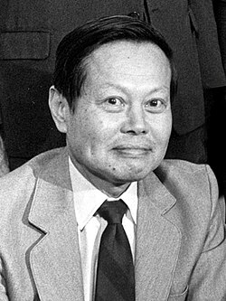
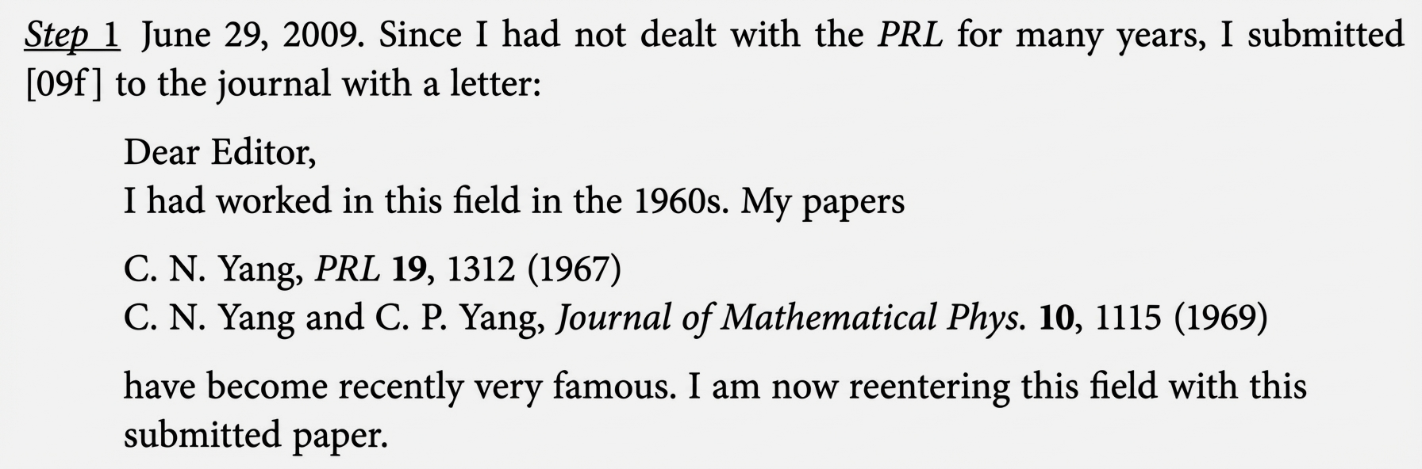
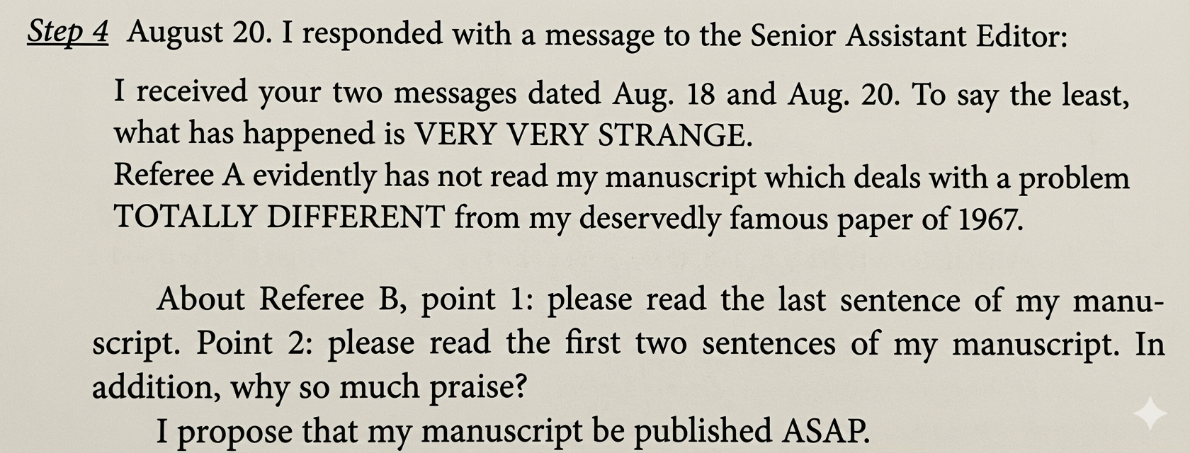
Anecdotal evidence from Yang Chen-Ning
A rejection email came from PRL after peer review on Aug 18 (50 days)…
A prompt reply rejecting his appeal on Aug 21 (1 day):
“The response you sent us will not advance the review of the manuscript. A more detailed rebuttal of the reviewers’ critique will be needed...”
24
Notes:
1957 Nobel Prize

Slide 25
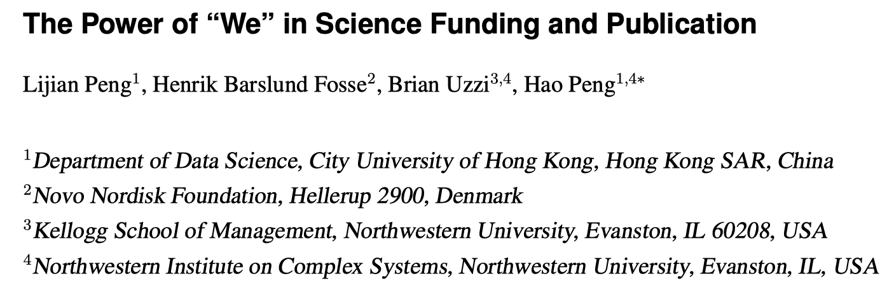
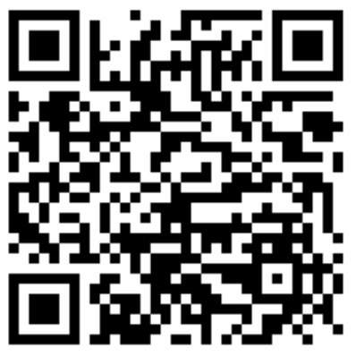
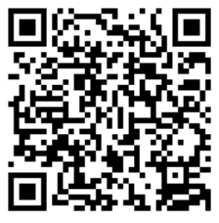
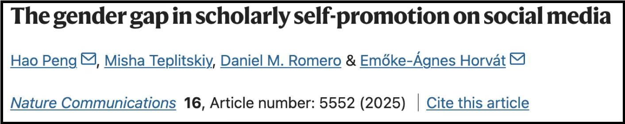
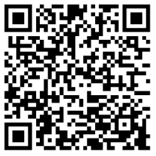
More details in our papers:

Slide 26



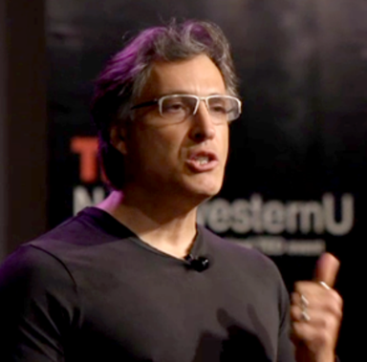


















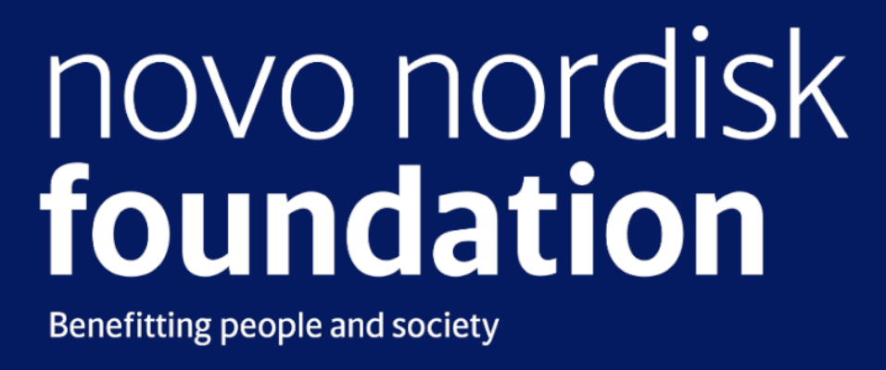

Acknowledgement
Thank You!
Lijian Peng
Sophie Qiu
Henrik Fosse
Brian Uzzi
Funders
Data sources
Microsoft Academic Graph
Notes:
Finally, I would like to acknowledge my awesome collaborators, and funders and organizations who provided resources and datasets in our research.

